Slide 1
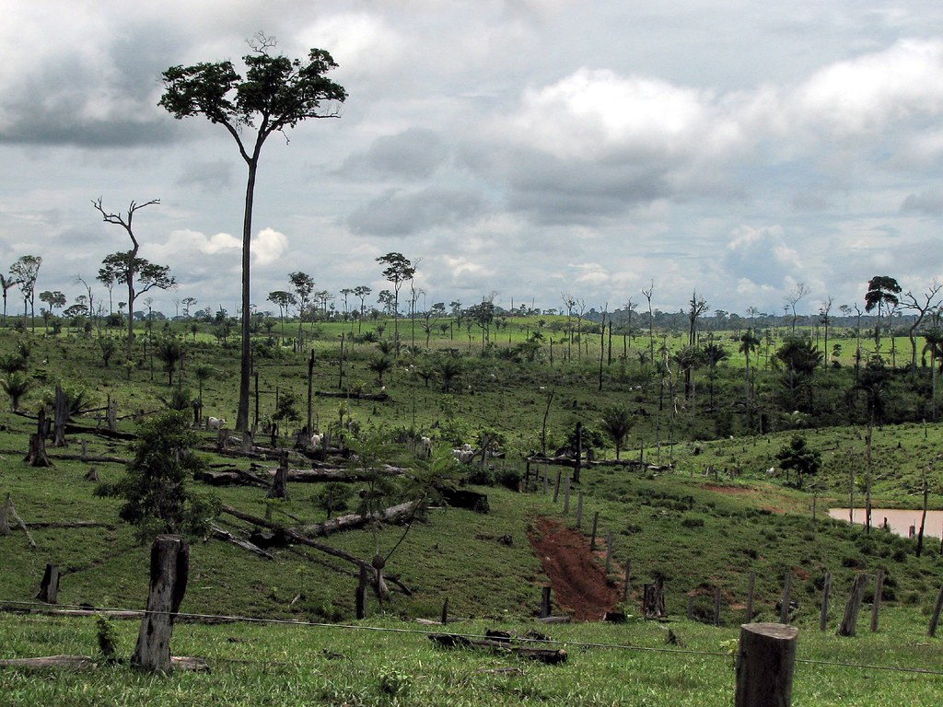
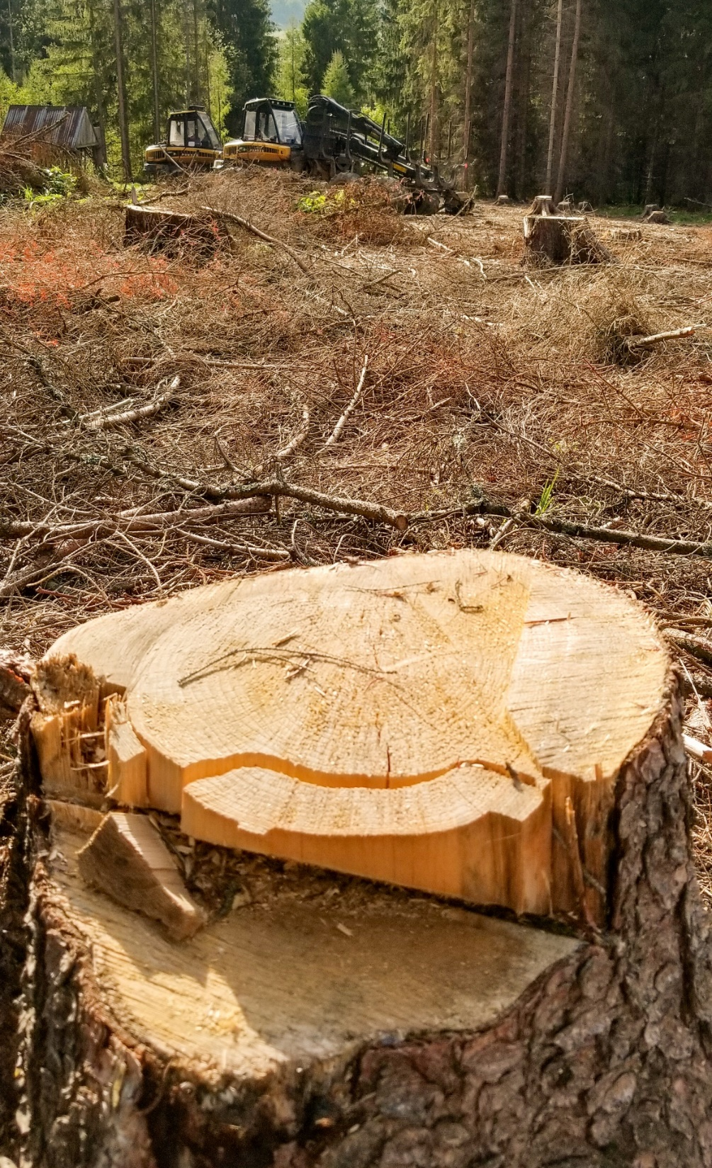
deforestation
Deforestation is the conversion of forests, through the clearing of trees, to other land uses or the long-term reduction of tree canopy cover to below 10%. Deforestation is often done for commercial or human needs

Slide 2
CAUSES OF DEFORESTATION
1. Expansion of agricultural land.
2. Livestock grazing.
3. Logging and wood harvesting.
4. Urbanization and expansion of cities.
5. Human population growth.
6. Increased need for resources.
7. Slash-and-burn techniques.
8. Expansion of manufacturing and industrial sites.
9. Intensive crop cultivation.
10. Over-exploitation of natural resources.

Slide 3
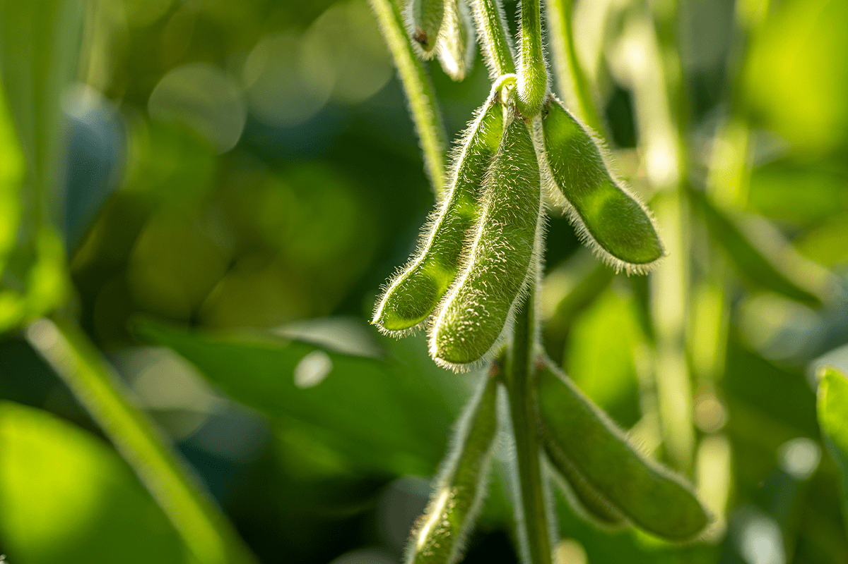
1. Expansion of agricultural land
One of the leading causes of deforestation is the expansion of agricultural land, accounting for more than 70% of deforestation rates. Agricultural practices, such as clearing vast areas of forest for farming, logging, and fuelwood use, are primary activities that contribute significantly to deforestation.

Slide 4
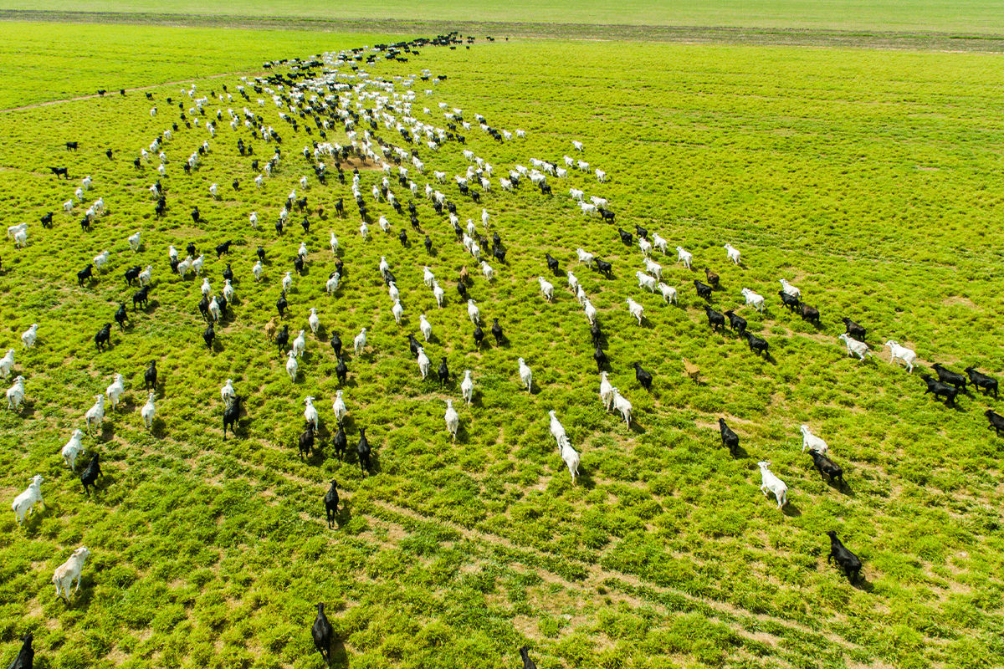
2. Livestock grazing
Livestock grazing, particularly for meat production, is also a significant cause of deforestation. Farmers often clear vast areas of land to create grazing pastures for their livestock, contributing to the loss of forested land. The degradation of soil resulting from overgrazing often also leads to repeated clearing and deforestation.

Slide 5
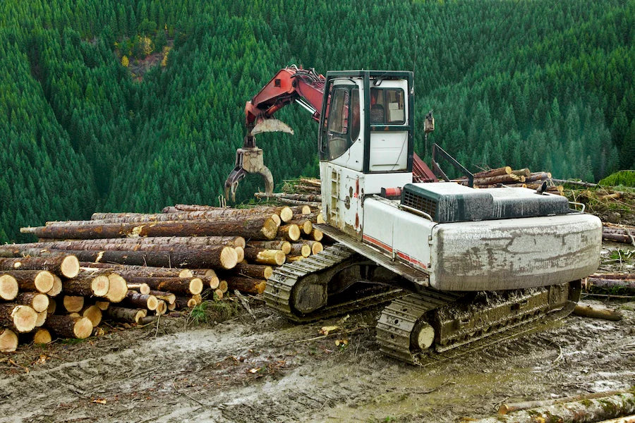
3. Logging and wood harvesting
Logging and wood harvesting are among the leading causes of deforestation across the world. Unfortunately, this often leads to unsustainable logging practices that destroy millions of hectares of forested land every year.

Slide 6
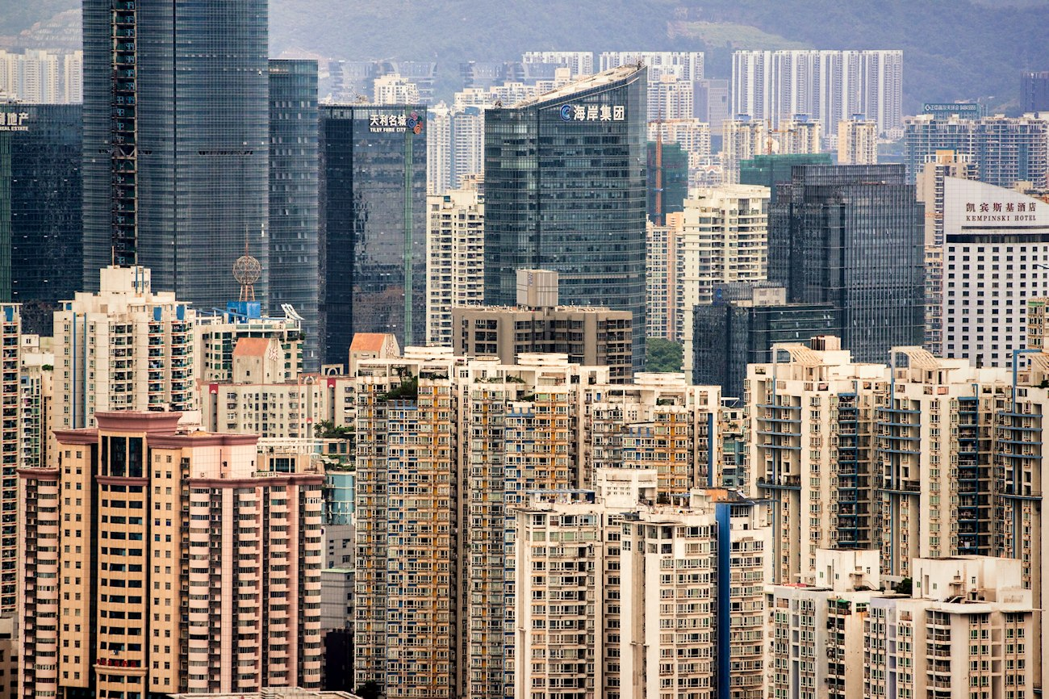
4. Urbanization and expansion of cities
Urbanization and the expansion of cities have a significant impact on deforestation, contributing to the destruction of forested land across the globe. As urban areas grow, they require more resources to sustain their populations, increasing demand for products like beef and agricultural goods.

Slide 7
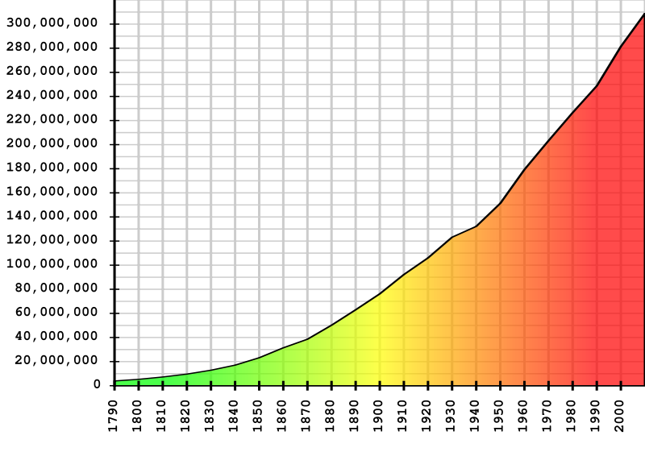
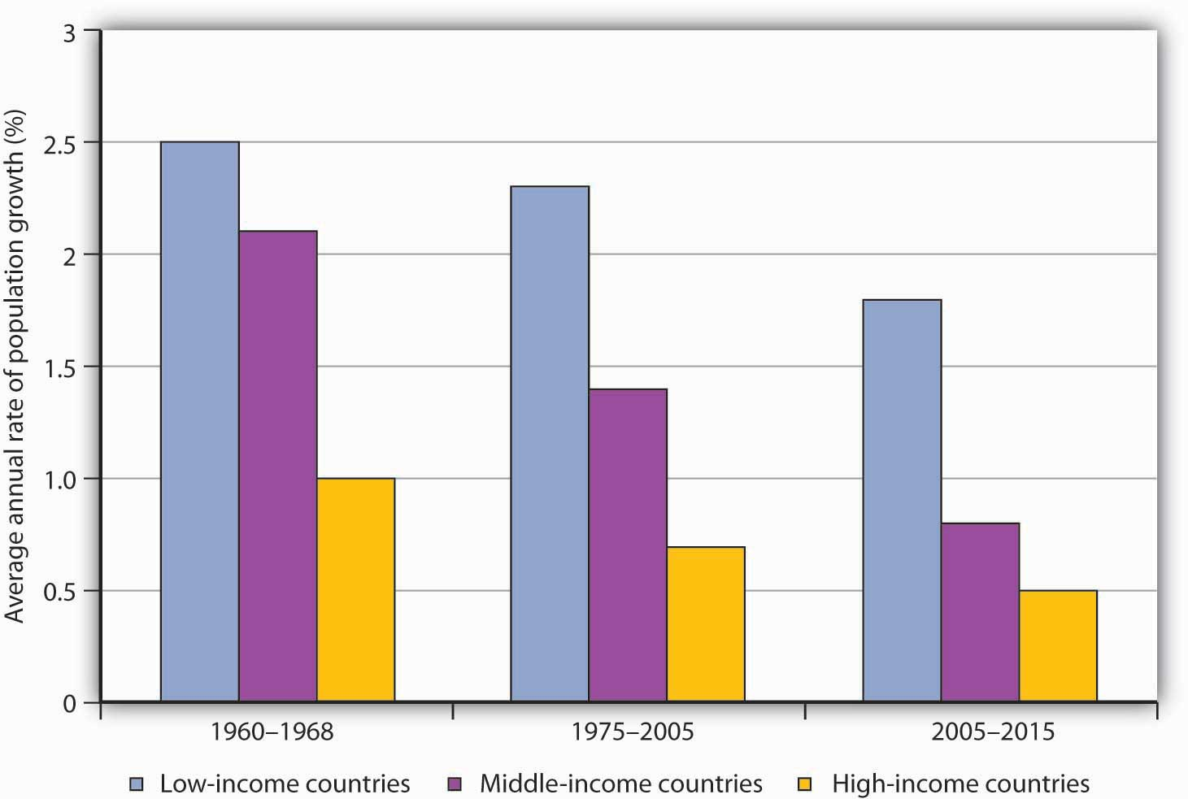
5. Human population growth
As the world's population continues to grow, the demand for food, housing, and natural resources also increases. This directly impacts deforestation as the need for more land for agriculture and settlements fuels the conversion of forests into farmland and urban areas.

Slide 8
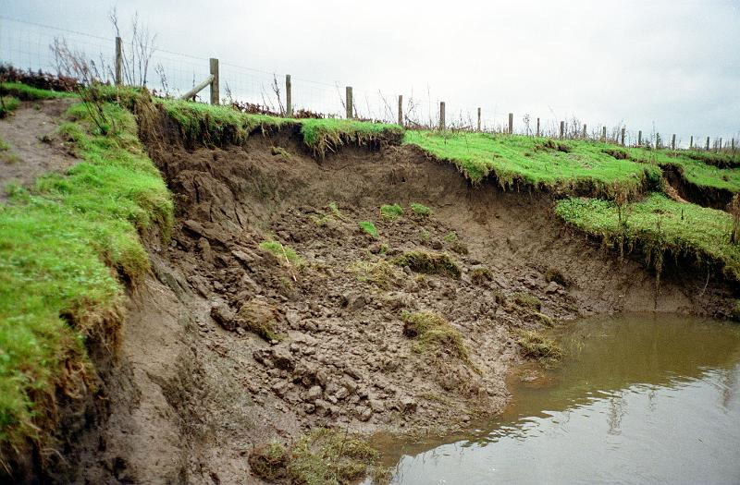
Effects of Deforestation
1. Millions of acres are destroyed
2. Unsustainable agricultural development
3. Immense biodiversity loss
4. Major contributor to the climate crisis
5. Soil Erosion

Slide 9
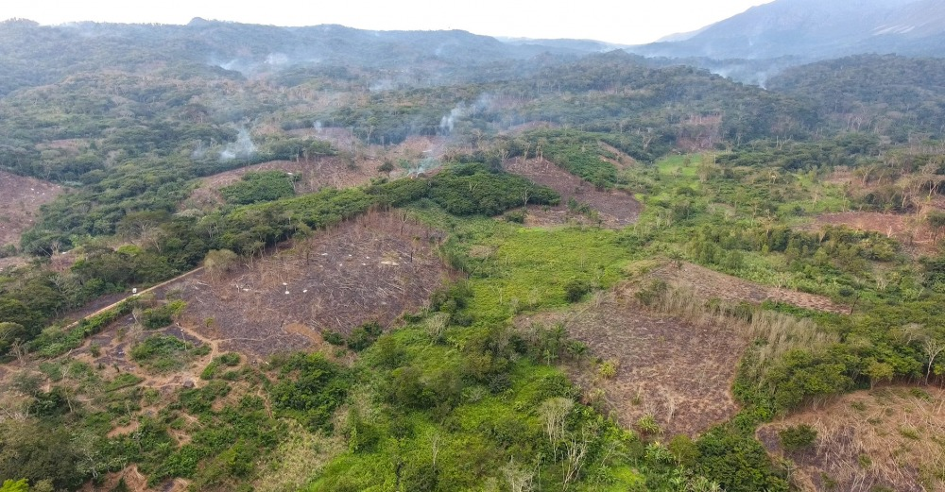
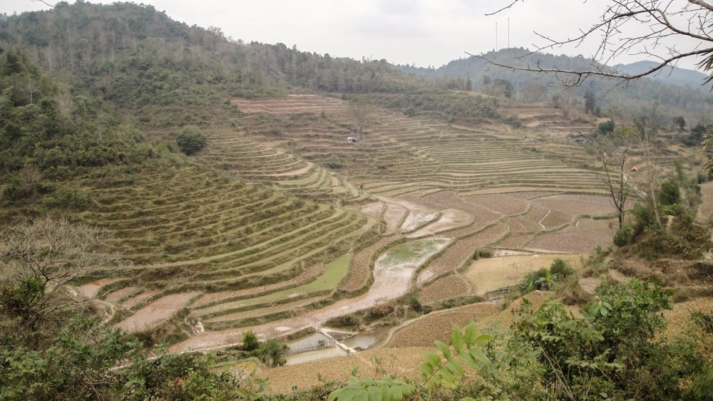
1. Millions of acres are destroyed
Although exact statistics are difficult to determine, the World Resources Institute reported over 2.9 million .

Slide 10
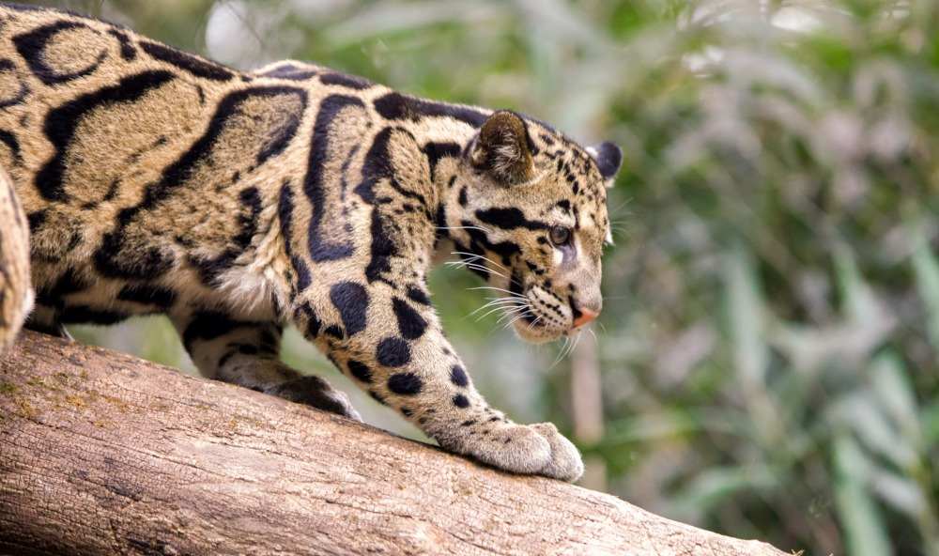
2. Immense biodiversity loss
Rainforests house 80% of the world’s terrestrial biodiversity, which is the foundation of life on Earth. For example, FAO states that one-quarter of all modern medicines are derived from rainforest plants. If these tropical forests are destroyed, we not only lose some of our most critical species, but also the potential for discovery of many others.

Slide 11
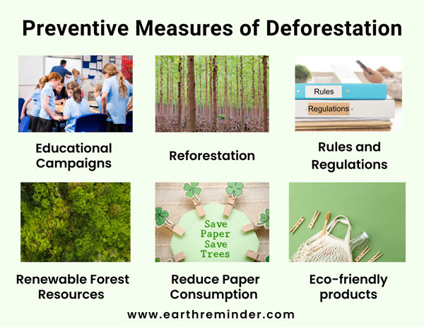
Control of Deforestation
Educational Campaigns
Reforestation
Use of Renewable Forest Resources
Reduce the Consumption of Paper

Slide 12
Conclusion-
Deforestation is a problem that affects us all, and it is one that we must work together to solve. The causes of deforestation are many and complex, but the effects are clear: loss of habitat for wildlife, loss of trees that provide vital ecosystem services, and contribution to climate change.

Slide 13
Thank you

